Slide 1
Quarterly Business Review
CFI - Financial Planning & Analysis
Q1 - 2026
Case Study - Nordstrom
Cole Hellie

Slide 2
Cole Hellie
Key Topics
Tariff Impact Analysis
Impact of additional cost due to tariffs. Look into how it will impact profits and identify possible short and long term solutions
End of Season Inventory
Significant amount of leftover inventory from Q2 and how some of the losses can be mitigated
Corporate Strategy
Shift in corporate strategy - Identifying the operational and technical impacts
Q1 - 2026

Slide 3
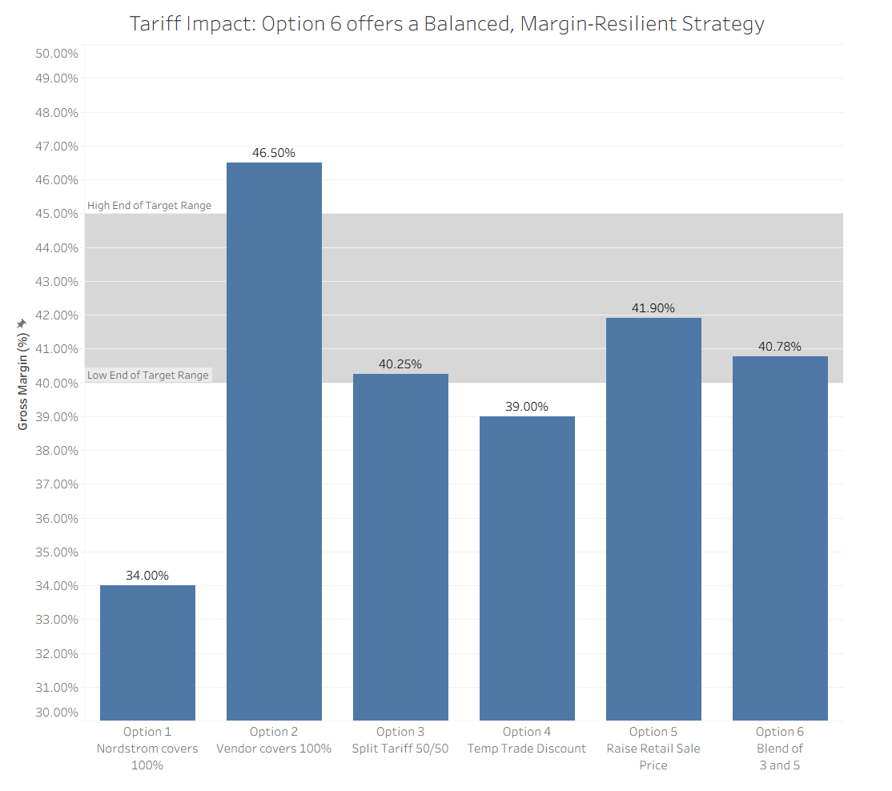
Cole Hellie
Tariff Impact
Q1 - 2026
Scenario: The U.S. government suggests it will impose a 25% import tariff on Canadian manufactured goods in the next few weeks
Neither Nordstrom or Vendor want to cover the tariff in full as it cuts into both parties margins. Can also significantly impact vendor relationship
Recommendation: Option 6

Slide 4
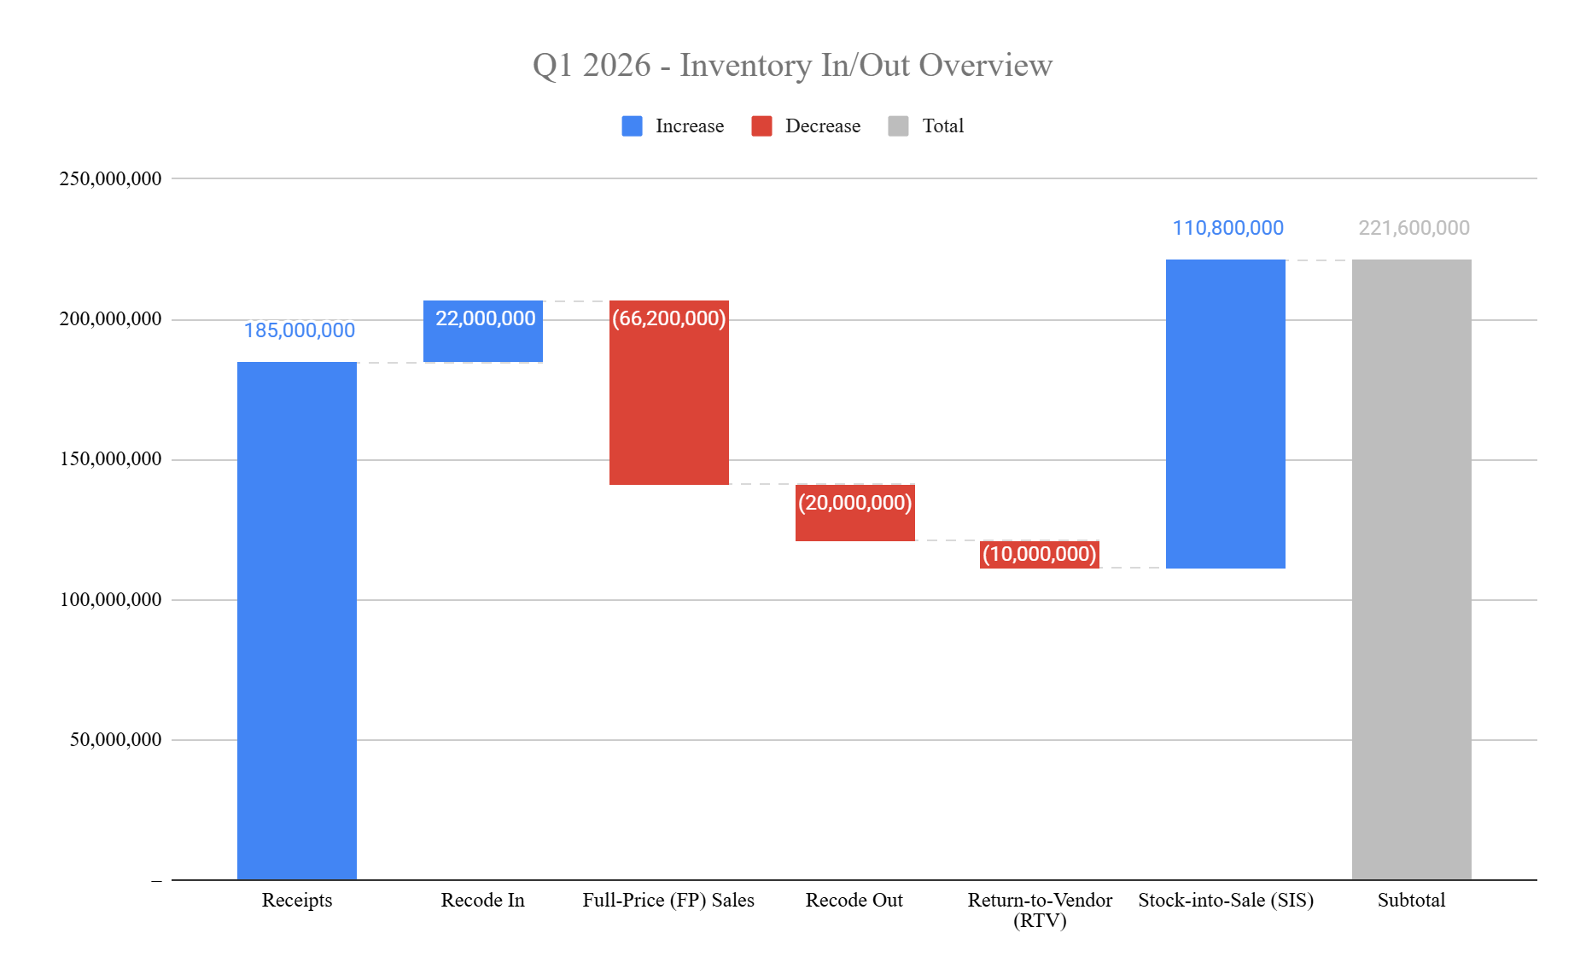
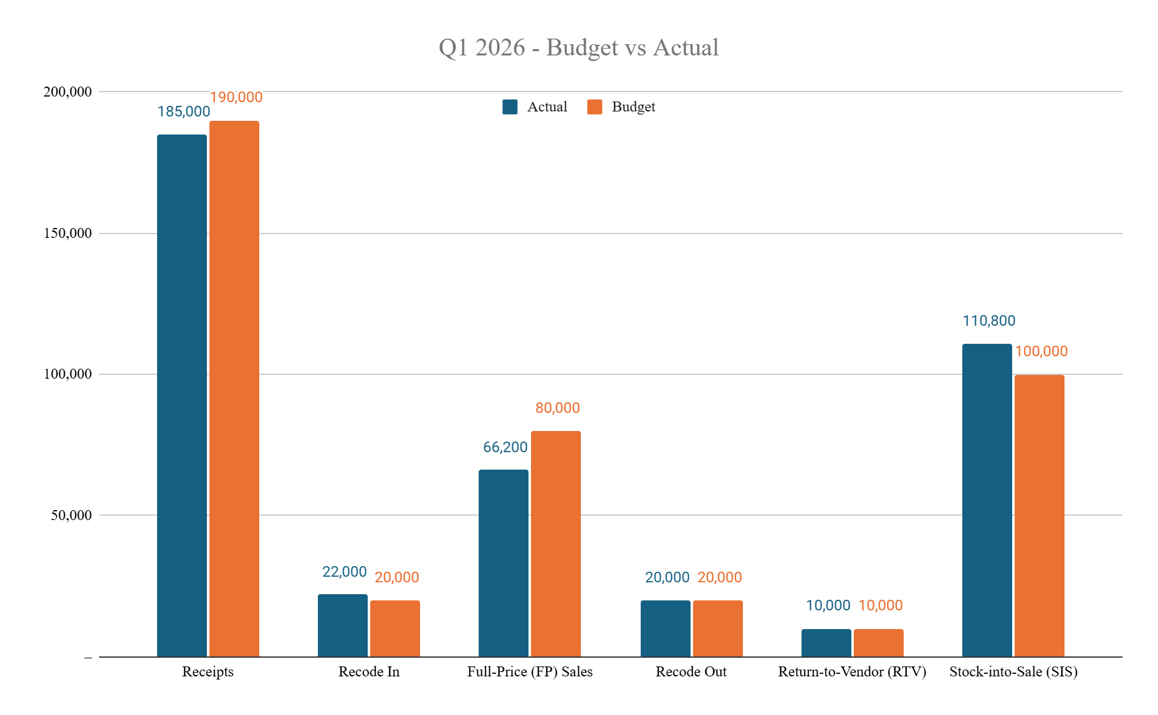
Cole Hellie
Q1 2025 Inventory
Year/Quarter/Month
Scenario: The consumer luxury industry has been feeling pressure due to the combined effects of economic uncertainty and elevated interest rates. Sales in the season have not been as strong as anticipated/budgeted, and as a business, Nordstrom has been pulling all the levers it can to reduce inventory risk.
Key Takeaways:
Executed 20% more in-season cancellations year-over-year as sales were significantly underperforming our target
Inventory moved from prior season into the current was on par with budget
We sold 17% less inventory at full price versus budget
Inventory moved out of current into next season was on-par with budget
Inventory we were able to return to vendor (RTV) was on-par with budget
Values in 000’s

Slide 5
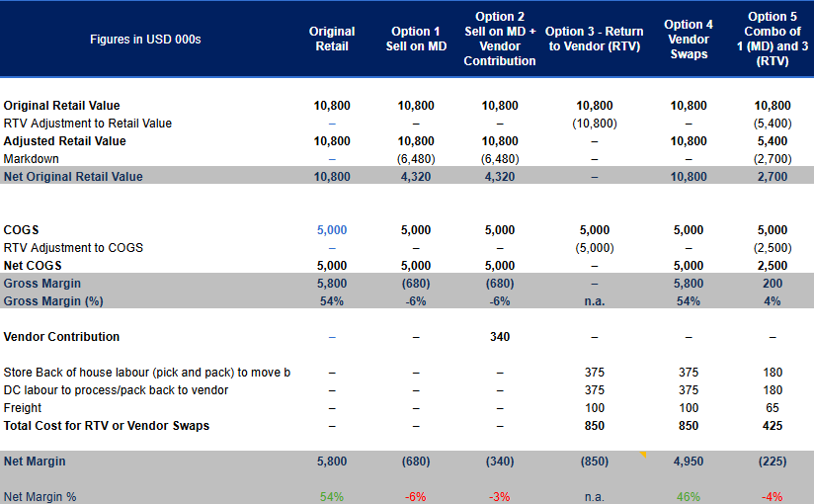
Inventory Strategy: Option 5 Balances Margin and Operational Feasibility
Scenario:
Option 1: The high volume of the products challenges the store layouts and may degrade the brand
Option 2: Vendor is unlikely to contribute today
Option 3: Unlikely for vendor to accept all leftover inventory and high labor costs
Option 4: Vendor confirmed they can not facilitate this
Option 5: Vendor confirmed they are open to partial sale and RTV. Preserves vendor relationship and brand image

Slide 6
Corporate Strategy Shift
Strategic Change | Operational Impacts | Tactical Response Plan | KPI / Financial Considerations
Marketing Strategy / Tactics | Adjust marketing strategies and tactics to promote new accessible brands with lower price points (Value Based) | Define the new target audience and identify the most effective marketing channels and social media platforms to reach them. This can be supported through early-stage A/B testing to evaluate options | Impressions New customer acquisition
Retail Readiness (Staffing and Training) | Retrain staff and update training materials to ensure employees are prepared and educated on the new inventory offerings. | Create specialized training materials for the new brands to ensure all employees are familiar with the new clothing lines, product features, and pricing. | Customer satisfaction Conversion rates Sales performance by store
↑ SKU volume, ↓ unit price | Suppliers and employees will need to manage higher product turnover, increasing the demand for more frequent deliveries and additional staff availability to restock shelves efficiently. | Assess current supply chain capacity and storage availability to forecast the required number of deliveries and determine how much excess inventory can be efficiently stored onsite. | Cost per Unit Labor hours

Slide 7
Corporate Strategy Shift cont.
Strategic Change | Operational Impacts | Tactical Response Plan | KPI / Financial Considerations
↑ Foot traffic, more casual shoppers | Casual shopper base may lead to a higher risk of theft, which will require increased floor staffing to monitor store activity and assist customers. Additional employees will also help maintain a strong customer experience | Add or upgrade store security measures, including increased staffing, enhanced camera coverage, and security tags on merchandise to help reduce theft. These improvements will support loss prevention | Skrink and loss prevention
Space Productivity Performance | Lower-priced goods will reduce overall margins, meaning available square footage must be used more efficiently to maintain profitability | Different store layouts should be evaluated to determine the most effective design for driving sales. Walmart is a great example of this as they strategically place all their items to optimize their space. | Sales per square foot Contribution per square foot

